Slide 1

IT Career Counselling Chatbot based on Industrial Trends
Group Members
Attay Rasool (P180046)
Daniyal (P180043)
Husni Ara (P190041)
Project Supervisor
Mr. Usama Musharaf

Slide 2
Introduction/Idea
•A career counselling chatbot is an AI-powered virtual assistant .
•It can help individuals with their career development journey.
•It has ability to provide personalized advice and support to users.

Slide 3
Literature Comparison
No | Year | Basic idea | Methodologies | Results | limitations
[1] | 2020 | by using NLP to tell students about university programs. | Using LSTM and then NLP to analyse the users demand | giving suggestions for college programs | Can’t differentiate between fake and authentic user
[2] | 2019 | to interact with users using speech to text for their convenience | Using Apache,Web Server,SQL,NLP | Gives industrial suggestions to a certain level | hold conversation to a certain level. Speech to text API was trial based.
[3] | 2022 | latest career guidance was considered and developed on Messenger Facebook. | Facebook SDK, Messenger API,javascript, Wit.ai API | help users by providing CV templates,Job listing | limited to Facebook users Needs high speed internet The system cannot hold a lot of conversations.

Slide 4
No | Year | Basic idea | Methodologies | Results | limitations
[4] | 2019 | to offer accessible and personalized career advice to students. | developed on Juji.Inc(a company allow users to create personalized chatbot ) | provides job listings and interview preparation tips | The bots conversation was carried out by using actual counselor.
[5] | 2020 | to support the admission counselling process in universities. | SGDC Classifier and SVM model to train model of subject recognition. | helps users to overcome difficulties,shortcoming and problems in admission | dataset of Q&A was not enough as data source system is not fully developed
[6] | 2020 | To solve queries of user’s as it is solved by a counsellor. | NLP, Knowledge Base | User don’t have to follow standard rules Voice to text used | Structured dataset used
[7] | 2022 | To develop a conversational agent on university website for ease of students to get admission related queries resolved quickly. | NLU,NLG,Knowledge Base | helps Users in admission procedures, study programs and scholarships | If the answers are not available, it will notify based on knowledge specified in default intent.

Slide 5
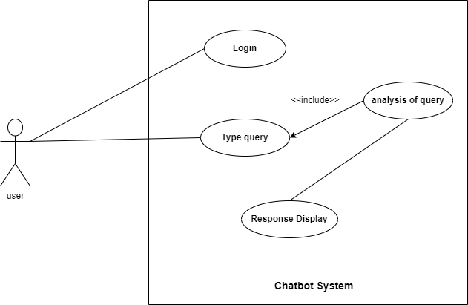
Use Case Diagram
Fig1: Use Case Diagram

Slide 6
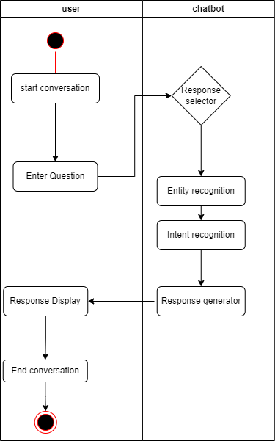
Swimlane Diagram
Fig2: Swimlane Diagram

Slide 7
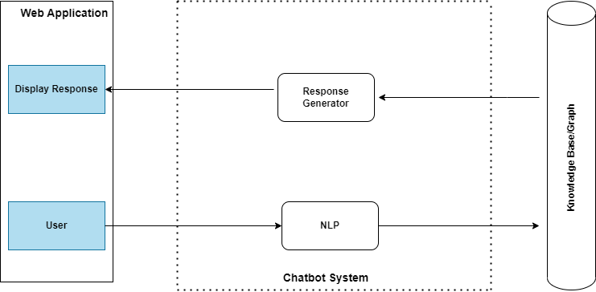
System Architecture
Fig3: System Architecture

Slide 8
Algorithm/Methodologies
NLTK
Bag of words
TF-IDF
Cosine Similarity

Slide 9
Expected result
FYP-1 Basic Chatbot prototype
FYP-2 Web Based Application with proposed Method

Slide 10
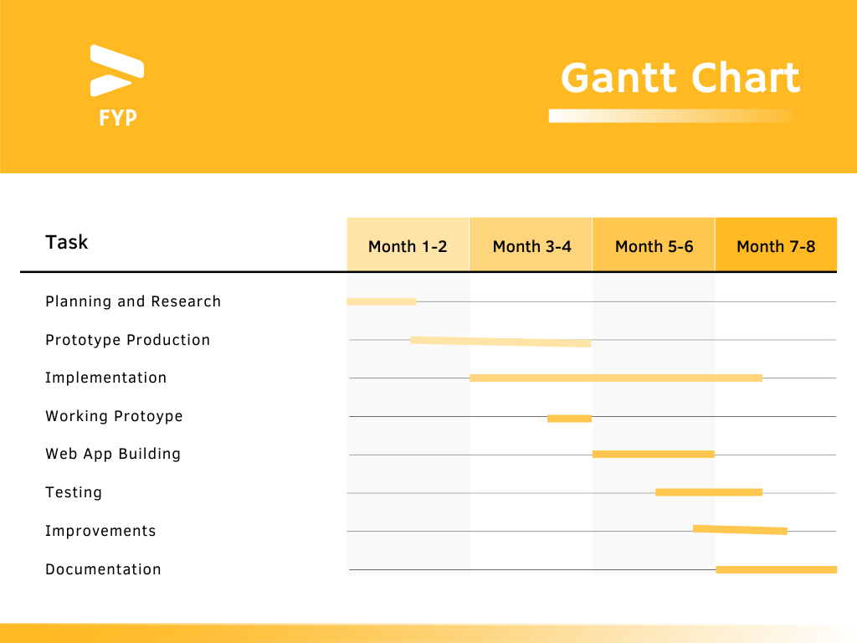
Timeline

Slide 11
Teamwork
Research paper and presentation work done by Daniyal.
Report work and System architecture done by Attay Rasool.
Diagrams work e.g, Use case, Swimlane Diagram done by Husni Ara.

Slide 12
References
[1]: Suresh, Nalina, et al. "Career Counseling Chatbot on Facebook Messenger using AI." Proceedings of the International Conference on Data Science, Machine Learning and Artificial Intelligence. 2021.
[2]: D’Silva, Godson, Megh Jani, Vipul Jadhav, Amit Bhoir, and Prithvi Amin. "Career counselling chatbot using cognitive science and artificial intelligence." In Advanced Computing Technologies and Applications: Proceedings of 2nd International Conference on Advanced Computing Technologies and Applications—ICACTA 2020, pp. 1-9. Springer Singapore, 2020.
[3]: Lee, Terri, Krithika Jagannath, Nitin Aggarwal, Ramamurti Sridar, Shawn Wilde, Timothy Hill, and Yu Chen. "Intelligent career advisers in your pocket? A need assessment study of chatbots for student career advising." (2019).
[4]:Le Hoanh Su, Truong Dang-Huy, Tran Thi-Yen-Linh, Nguyen Thi-Duyen-Ngoc, Ly Bao-Tuyen, and Nguyen Ha-Phuong-Truc. "Development of an AI Chatbot to support admissions and career guidance for universities." International Journal of Emerging Multidisciplinary Research 4, no. 2 (2020): 11-17.
[5]: Sonawane, Sarang Balkrushna, Asmita Sanjay Badwar, Rutuja Hemant Dalvi, Gaurav Nandakishore More, and Mr Sopan A. Talekar. "Design of Chatbot System for Student Counselling." International Journal of New Innovations in Engineering and Technology 13, no. 3 (2020): 2319-6319.
[6]: Banerjee, Anshika. "Text and voice-enabled chatbot enhancing the user experience in career counselling domain." PhD diss., Dublin Business School, 2019.

